Slide 1
An Engineering Approach to Bio-Constrained Neural Control with an Eye Toward Adaptability
Tiffany Hamstreet
Master’s Project, Mechanical Engineering
Portland State University
July 13, 2018

Slide 2
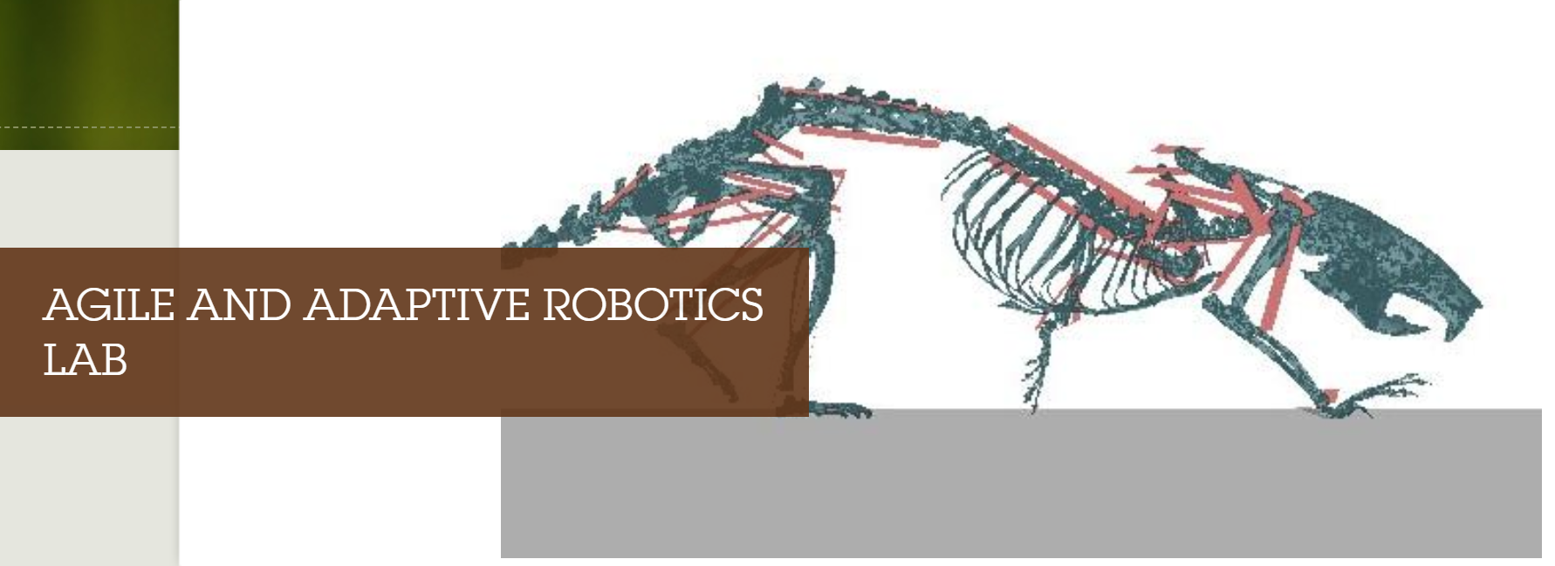
In the Agile and Adaptive Robotics Lab, we are interested in uncovering and leveraging biological mechanisms to perform adaptive control
We are researching the mechanisms of human balance and locomotion

Slide 3
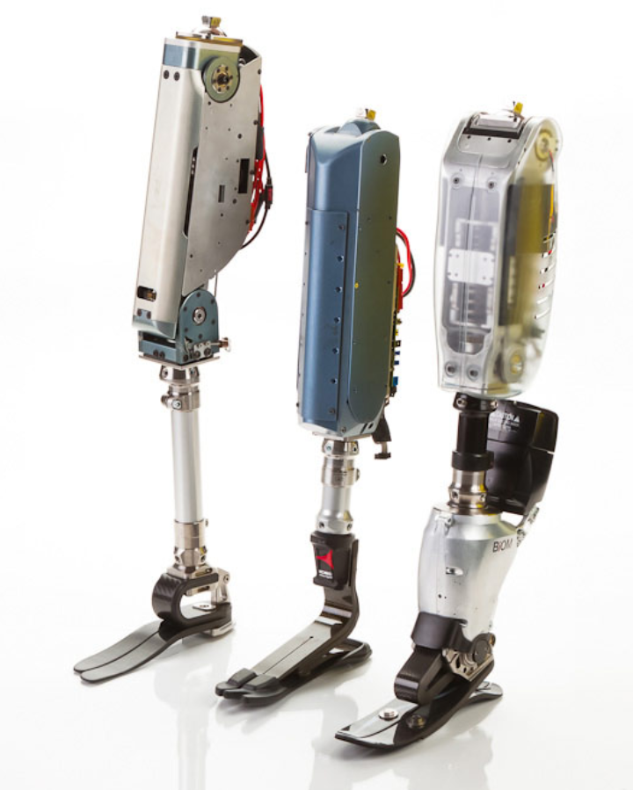

The human balance control system adapts continuously to growth, injury and environment
A realistic model will improve bio-inspired design of
More natural prosthetics
Rehabilitation devices
Helpful bio-inspired robots
Notes:
Image credit: http://biomech.media.mit.edu/portfolio_page/cseaknee/ https://www.bostondynamics.com/bigdog

Slide 4
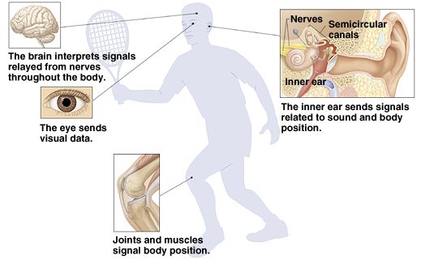
Human balance incorporates sensory information from eyes, ears, and muscles
Vision: orientation relative to structural environment
Vestibular system: orientation relative to gravity
Proprioceptive: relative joint orientation

Slide 5
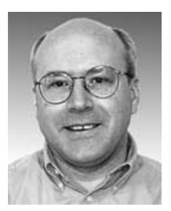
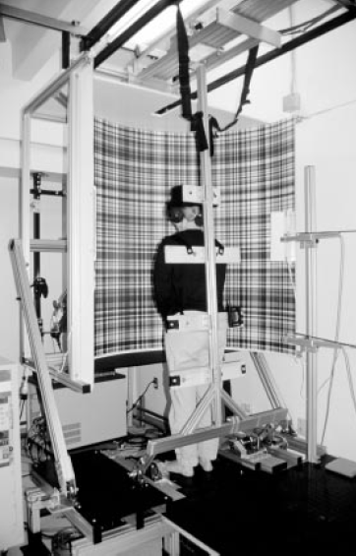
Extensive testing has been conducted to determine the sensory contributions to human balance
Courtesy of Dr. Robert J. Peterka, OHSU
Sensory deprivation via
Blindfolds
Vestibular loss due to illness or injury
Balance perturbations via
Moving surface
Moving visual surround
Analysis conducted using classical control theory

Slide 6
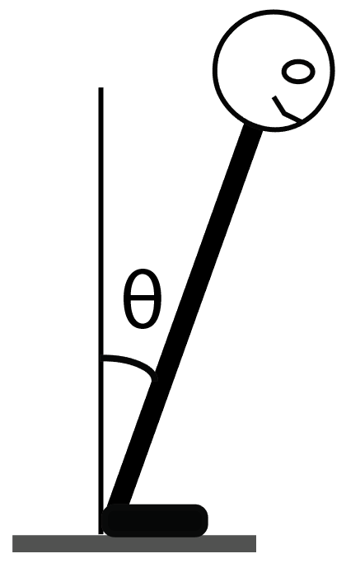
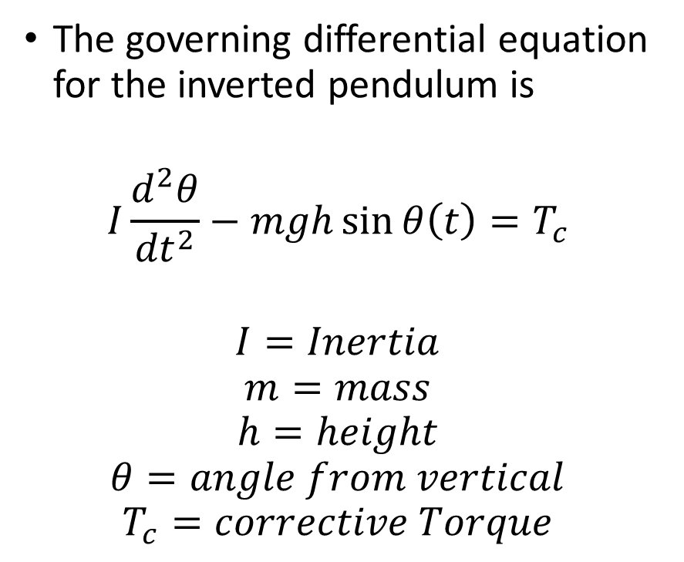
The simplest model for human balance is the inverted pendulum
The governing differential equation for the inverted pendulum is
$$I\frac{d^{2}θ}{{dt}^{2}}−mgh\sin{θ\left(t\right)}=T_{c}$$
$$I=Inertia$$
$$m=mass$$
$$h=height$$
$$θ=angle from vertical$$
$$T_{c}=corrective Torque$$

Slide 7
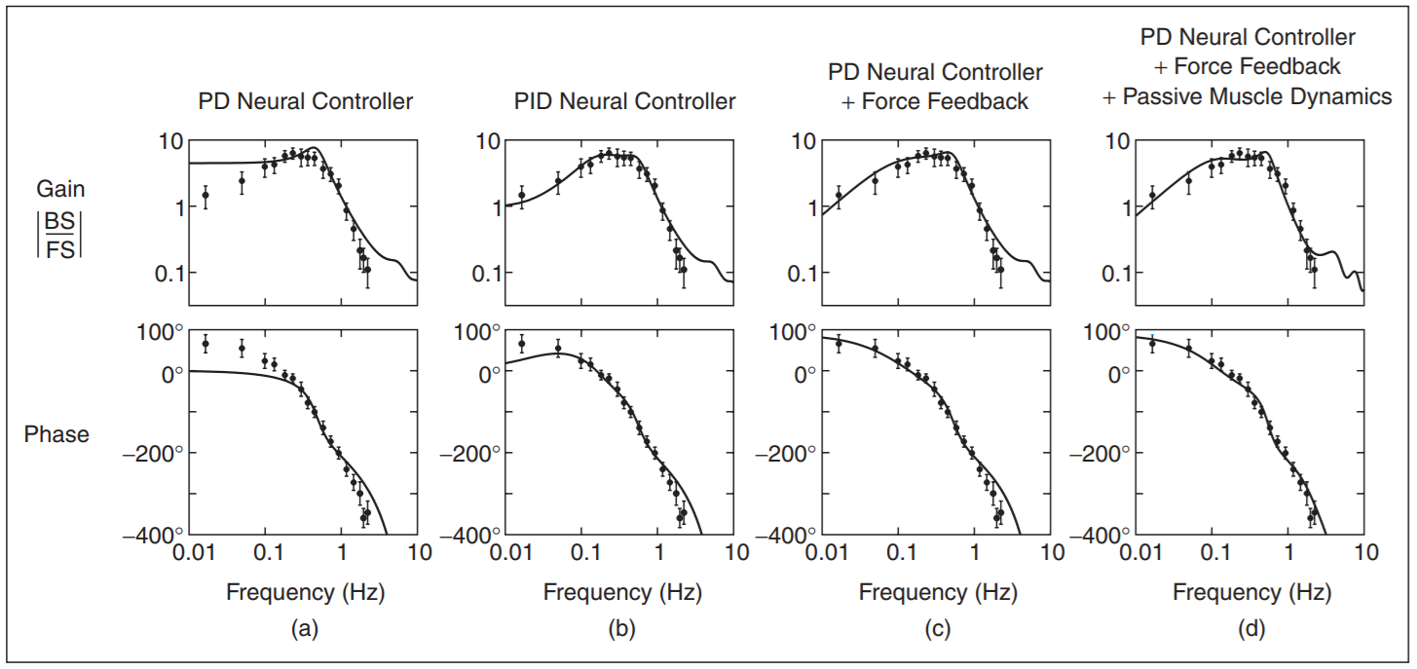
The simplest classical controller that fits human balance data is a PD controller
Courtesy of Dr. Robert J. Peterka, OHSU

Slide 8
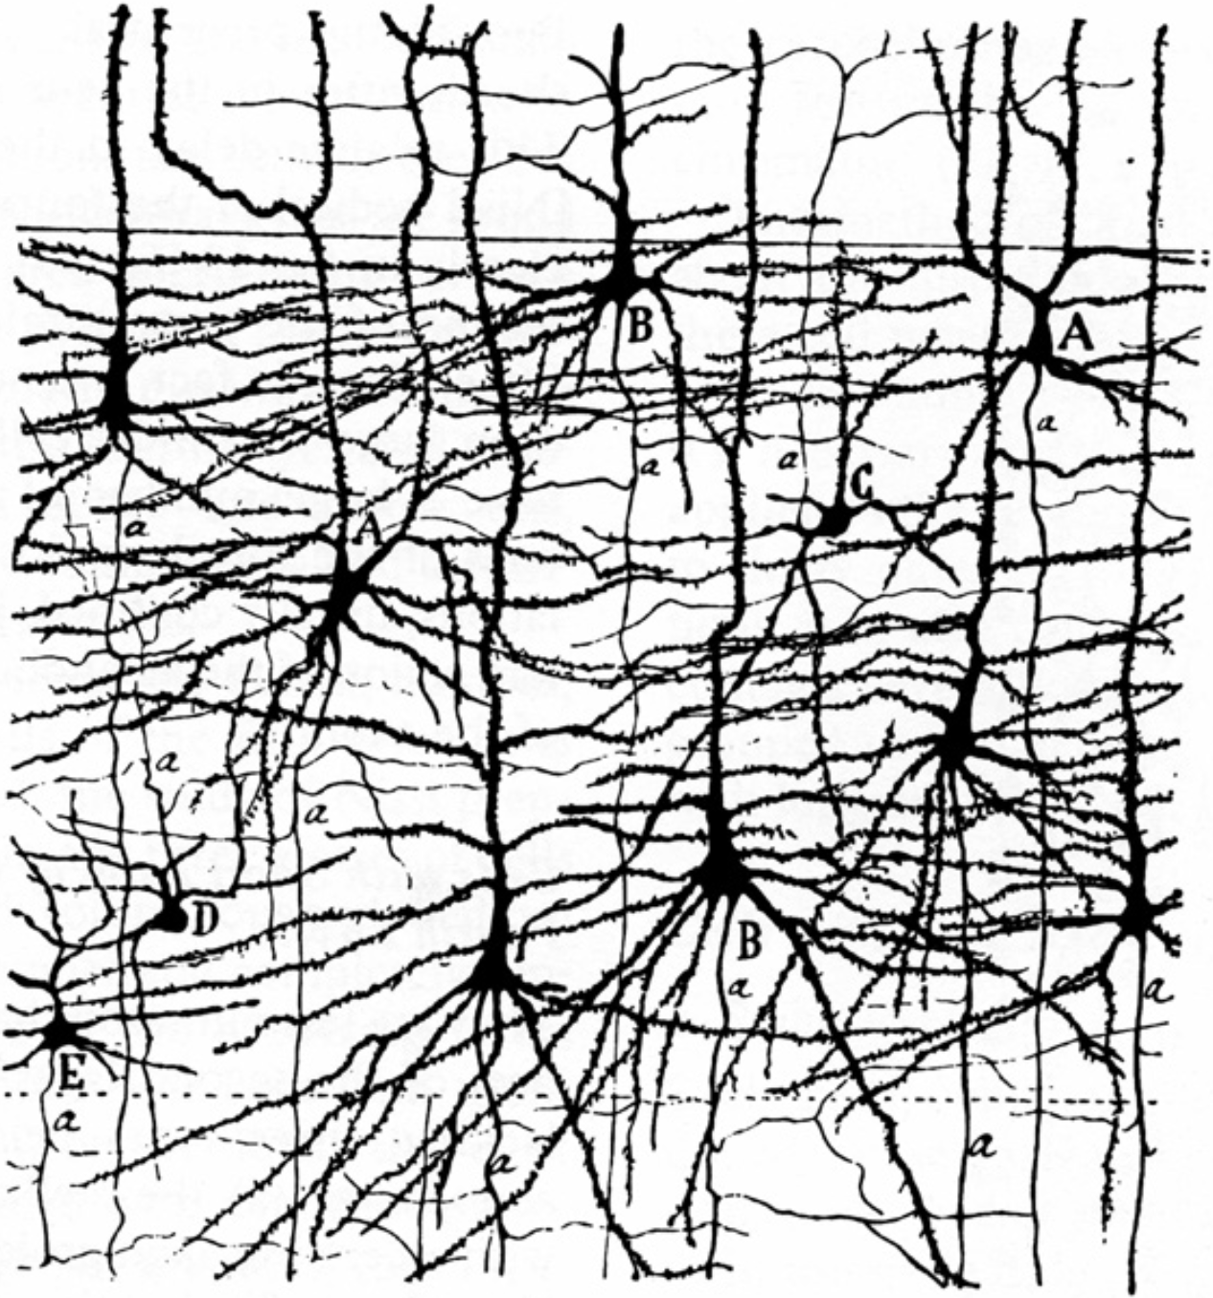
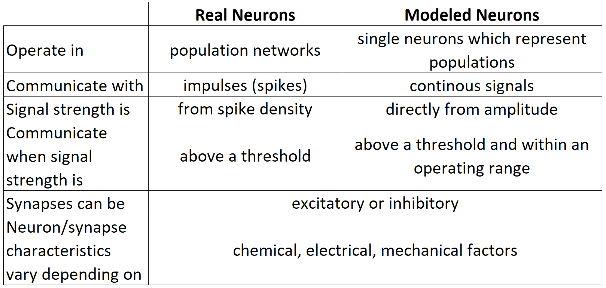
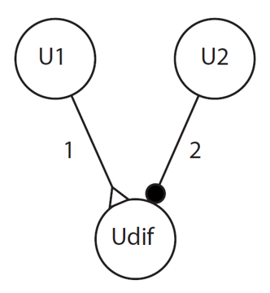
Non-spiking neural population theory is a simplification of real neuron behavior

Slide 9

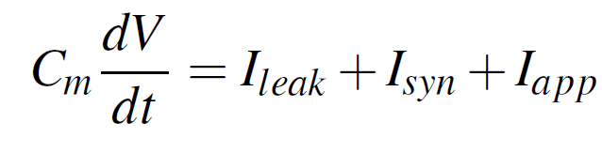
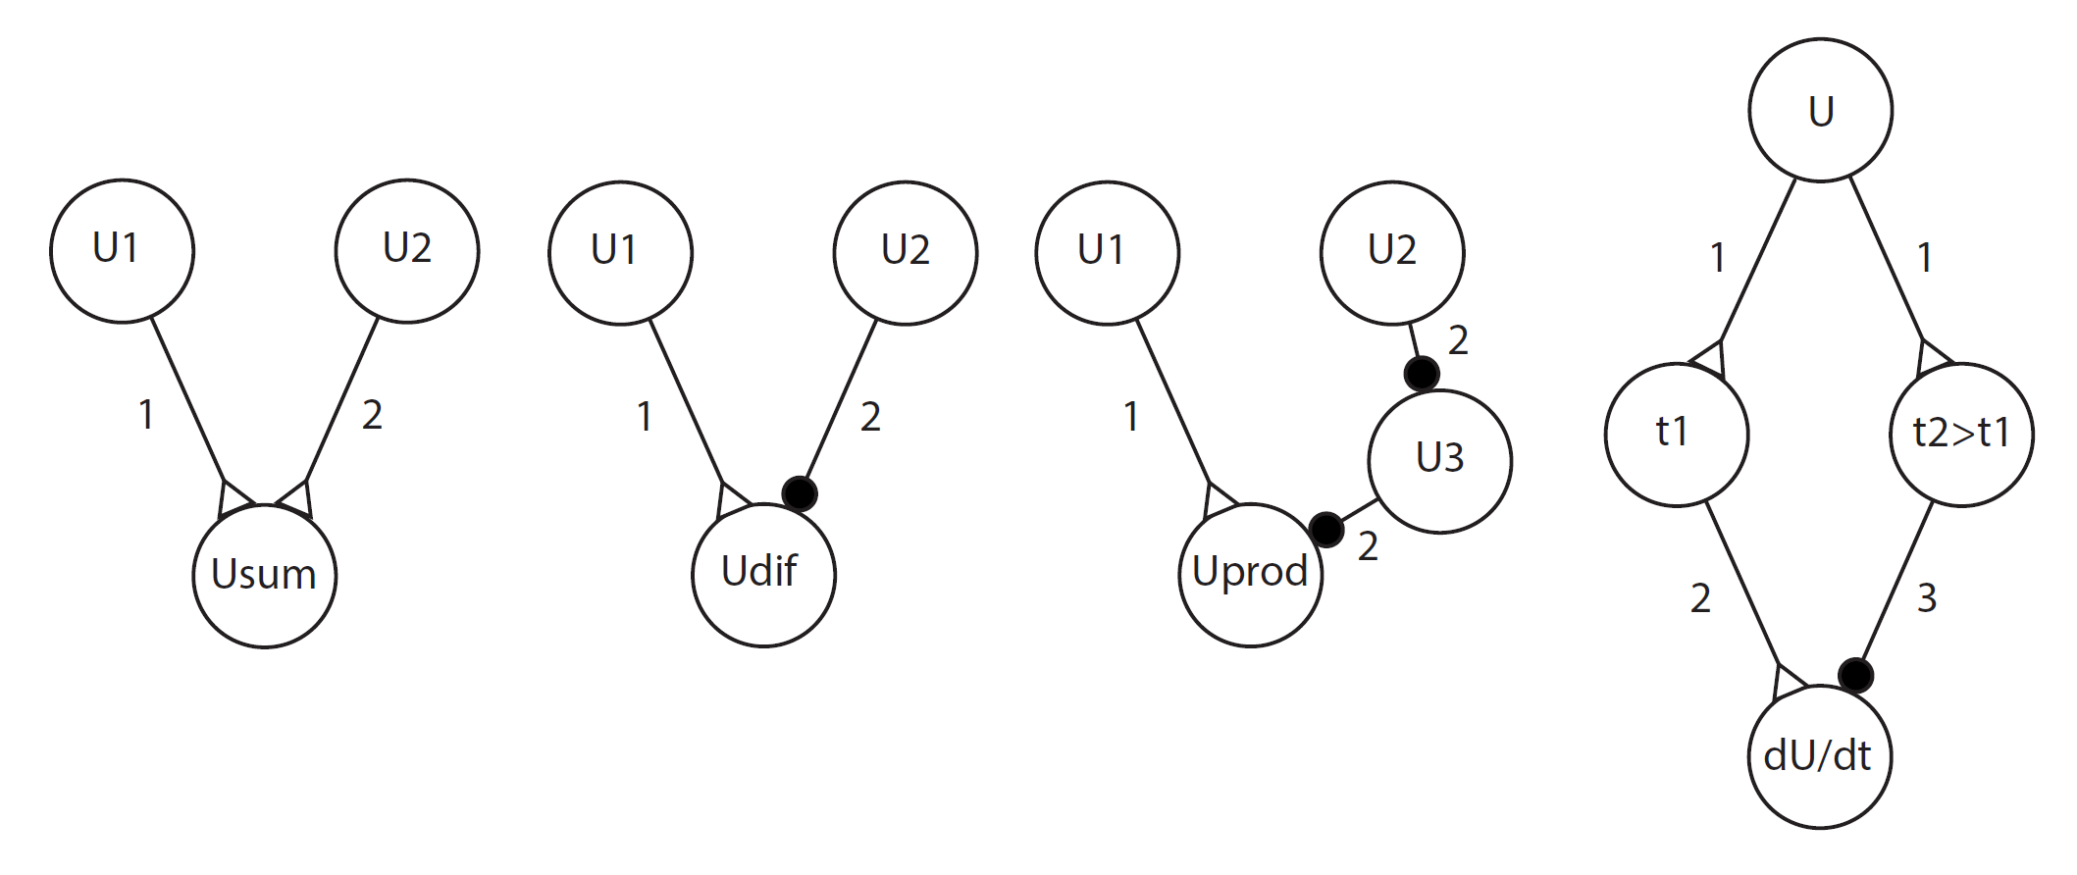
Neural subnetworks have been created from theory to approximate basic mathematical operations
Courtesy of Dr. Nick Szczecinski, Case Western
From left to right: Addition, Subtraction, Multiplication and Derivative

Slide 10
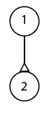
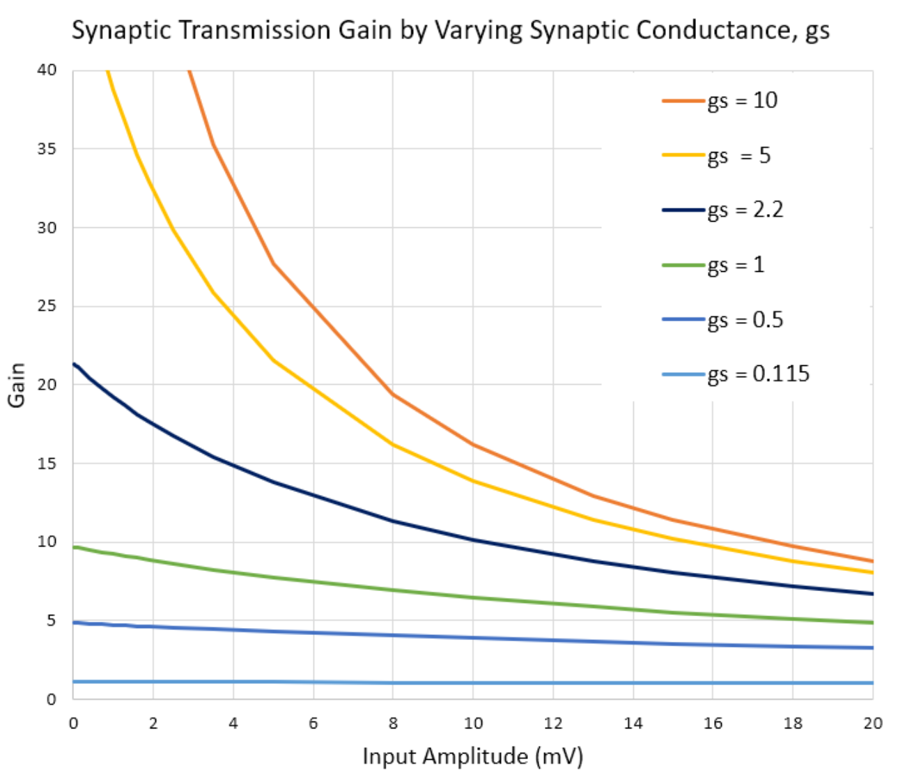
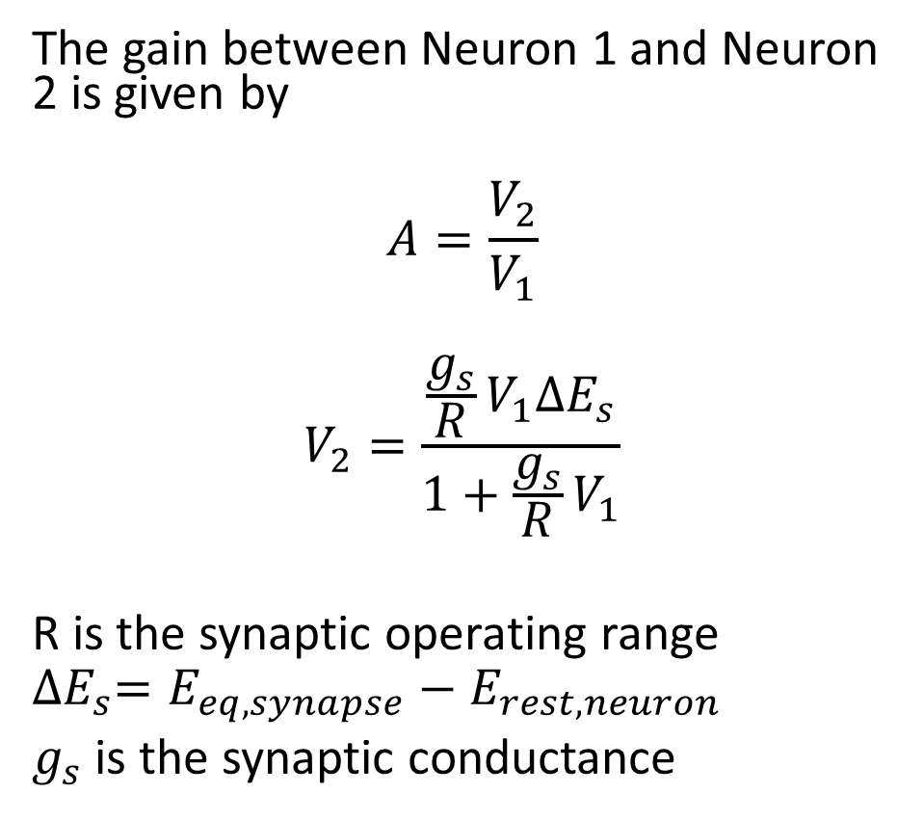
Even the most basic synaptic transmission shows non-linear input dependence
The gain between Neuron 1 and Neuron 2 is given by
$$A=\frac{V_{2}}{V_{1}}$$
$$V_{2}=\frac{\frac{g_{s}}{R}V_{1}{∆E}_{s}}{1+\frac{g_{s}}{R}V_{1}}$$
R is the synaptic operating range
$${∆E}_{s}=E_{eq,synapse}−E_{rest,neuron}$$
$g_{s}$ is the synaptic conductance

Slide 11

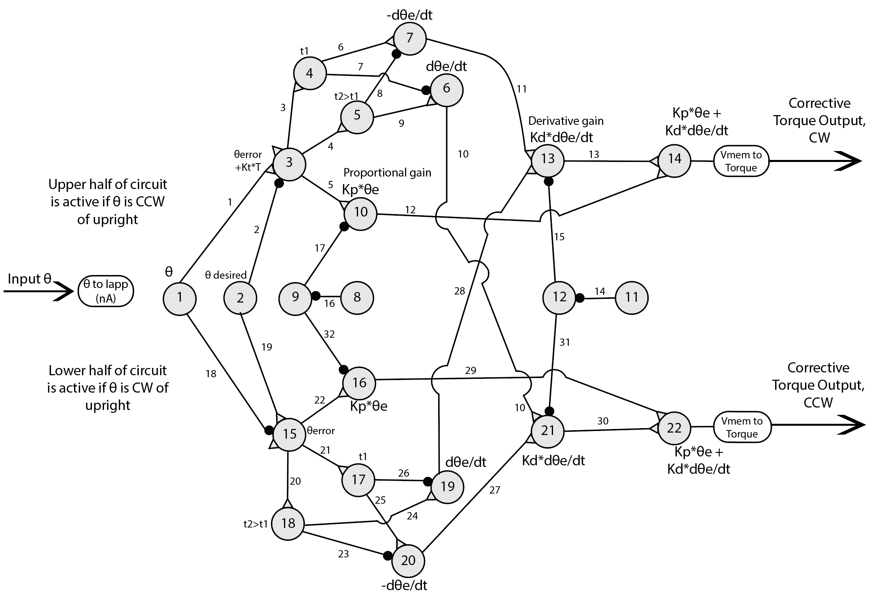
Each circuit and synapse contributes non-linear input dependence
Courtesy of Wade Hilts, MSME, PSU

Slide 12
We want to systematically explore the effect of input dependence in the neural balance controller and integrate adaptive circuitry
Introduce experimental methods
Start with simplest balance model and controller possible
Implement the controller in open loop and show input dependence
Close the loop and show input dependence
Tie back to human data
Incorporate first adaptive network components

Slide 13
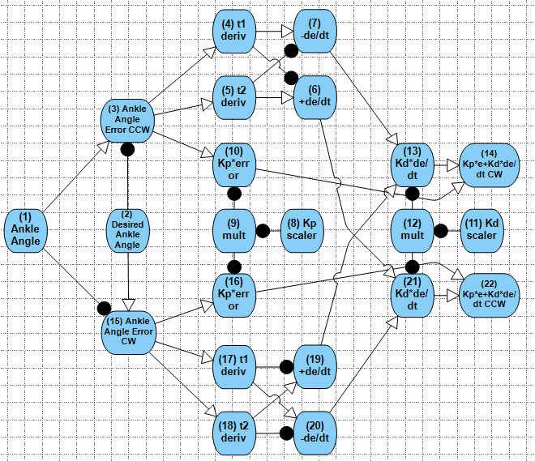
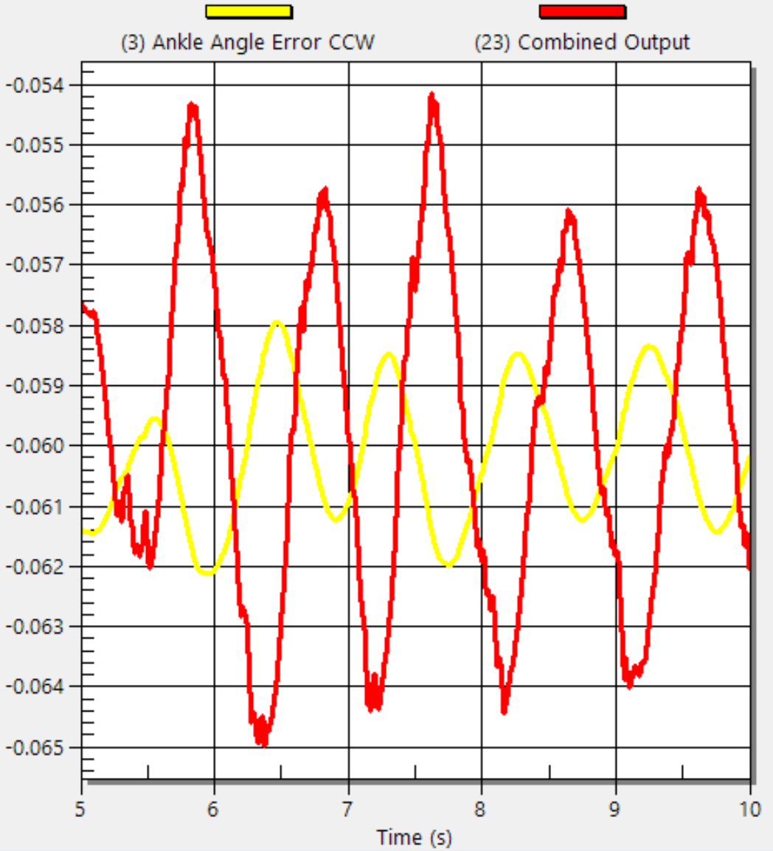

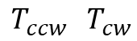
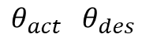
Matlab simulates the inverted pendulum and Animatlab simulates the neural control
Animatlab provides realistic simulations of biological systems and allows real-time observation of neural behavior
Matlab provides inverted pendulum simulation and data collection and analysis capabilities
$$θ_{act} θ_{des}$$
$$T_{ccw} T_{cw}$$

Slide 14
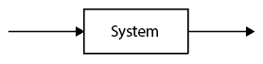
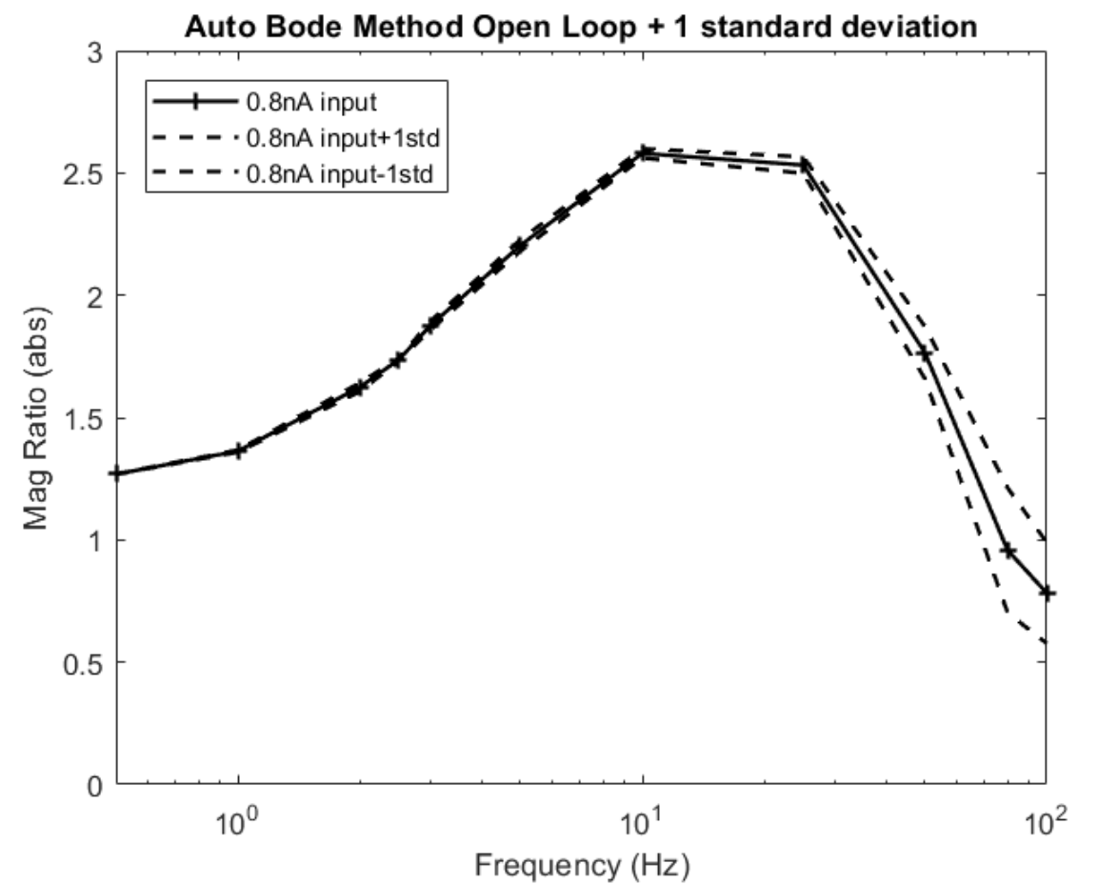
The frequency response provides output/input data over the frequency range of interest
The x-axis shows frequency in Hz on a logarithmic scale
The y-axis shows the ratio of the output amplitude divided by the input amplitude of the system
If the ratio is > 1, the input signal is amplified
If the ratio is < 1, the input signal is attenuated

Slide 15
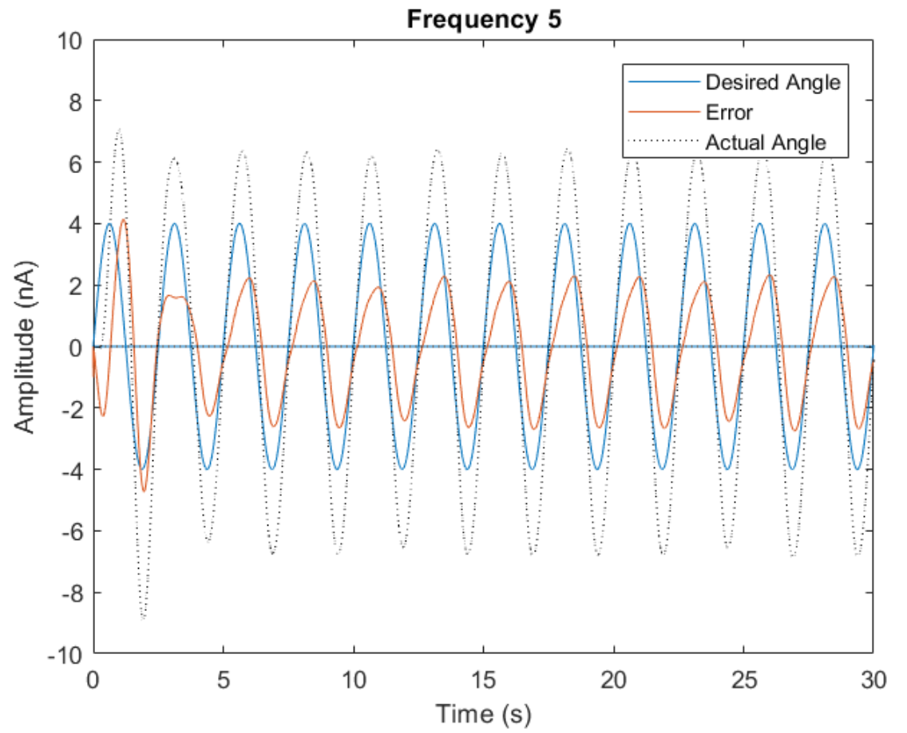
Auto Bode calculates output/input data one frequency at a time
Pros:
Time data is easy to interpret
Easy to compare datasets
Cons:
Miss data between frequency steps
Long trials for low frequencies
Notes:
ABOL_11(0.8) base standard deviation ABCL_9(4) used closed loop to show low freq higher freq noise that is lost in AB method

Slide 16
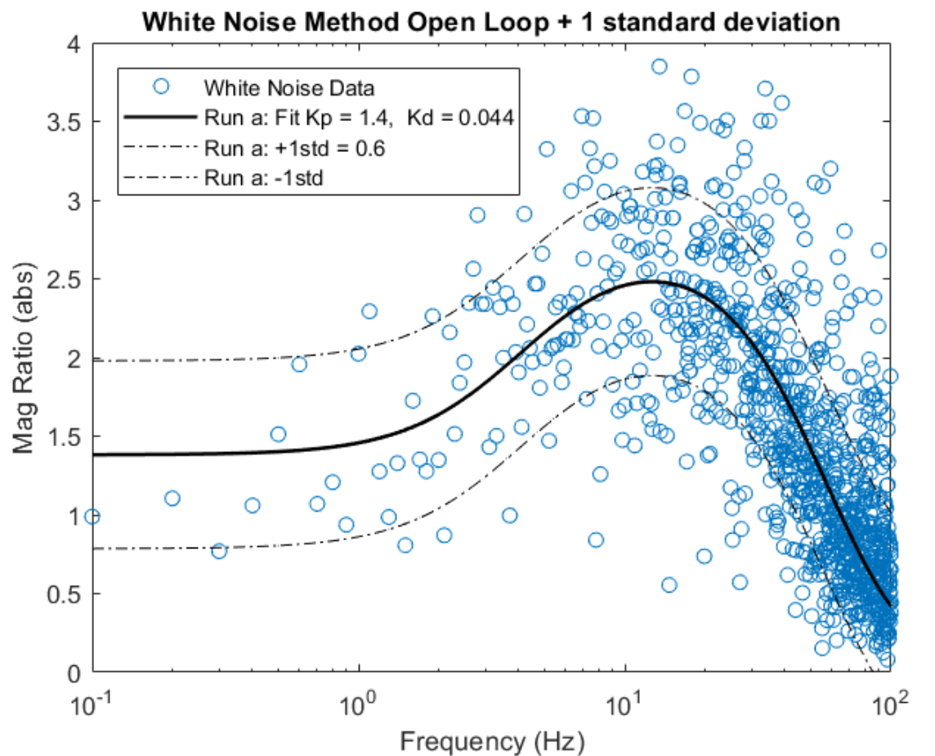
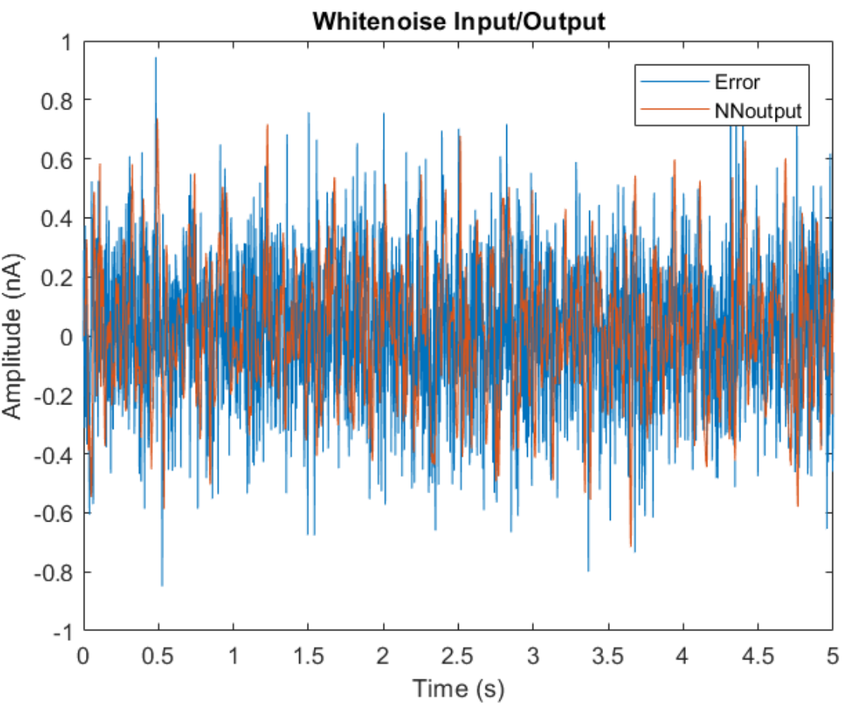
White noise input and Fourier transform calculates output/input data all at once
Pros:
No gaps in the data
Trial length is determined by the smallest desired frequency
Cons:
Time data is not informative
Difficult to compare datasets
Notes:
WNOL_61(0.2) base settings

Slide 17
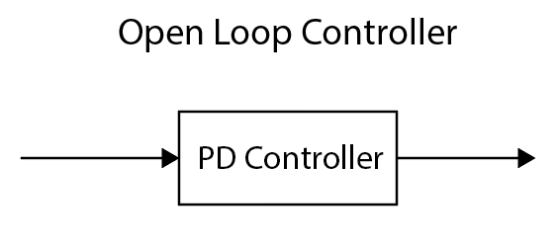
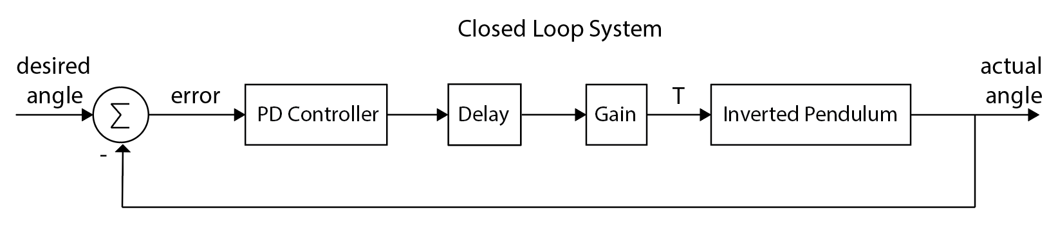
We will design the controller open loop then implement it in the closed loop system

Slide 18
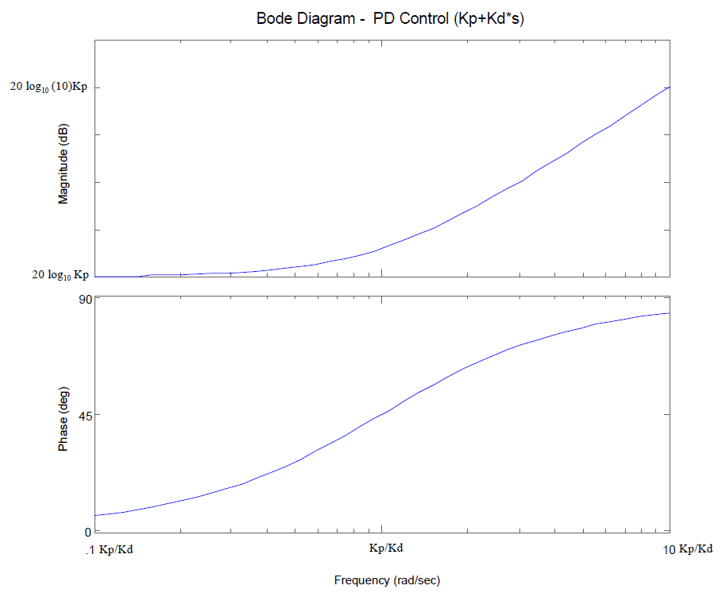
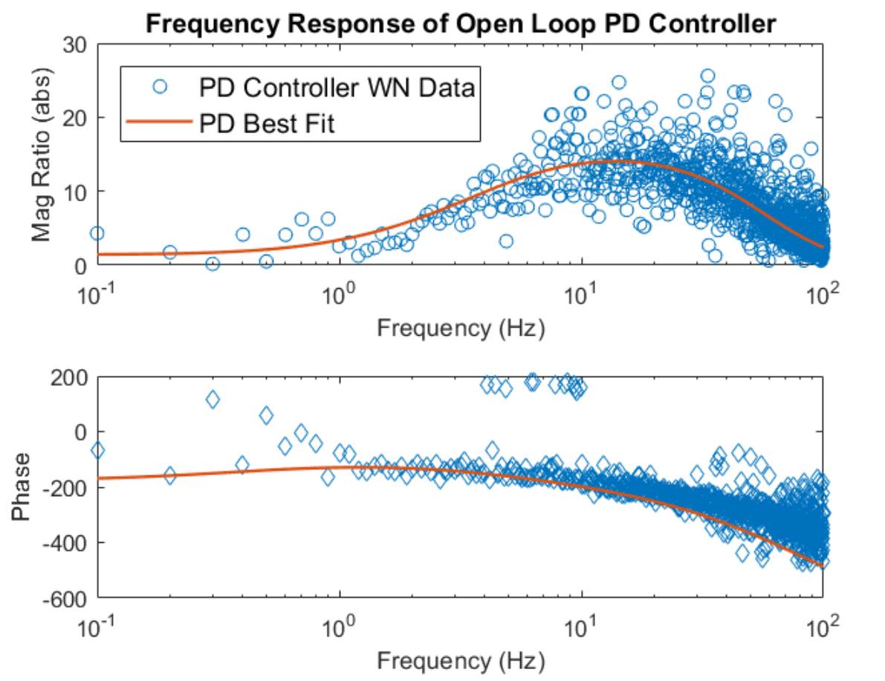
The frequency response of the neural PD controller is different from the classical PD
Classical PD Controller Response
Neural PD Controller Response

Slide 19
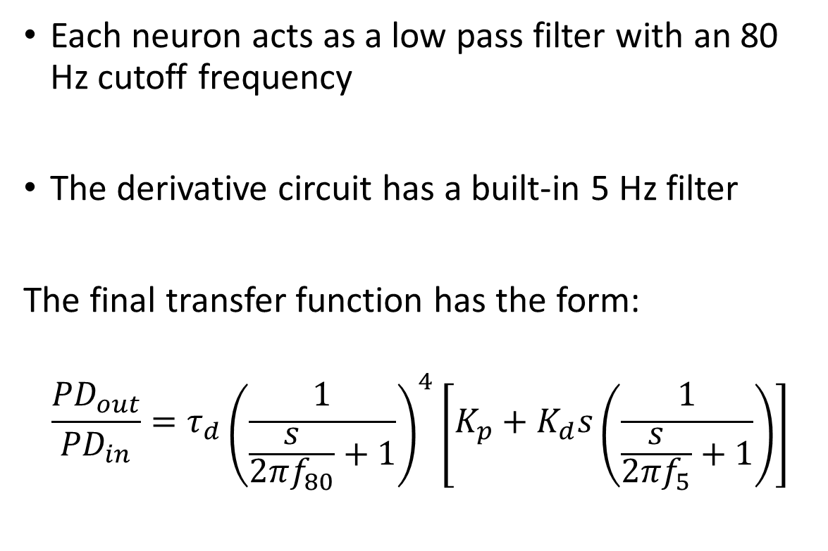
The neural open loop frequency response is influenced by low pass filters
Each neuron acts as a low pass filter with an 80 Hz cutoff frequency
The derivative circuit has a built-in 5 Hz filter
The final transfer function has the form:
$$\frac{{PD}_{out}}{{PD}_{in}}={τ_{d}\left(\frac{1}{\frac{s}{2πf_{80}}+1}\right)}^{4}\left[K_{p}+K_{d}s\left(\frac{1}{\frac{s}{2πf_{5}}+1}\right)\right]$$

Slide 20
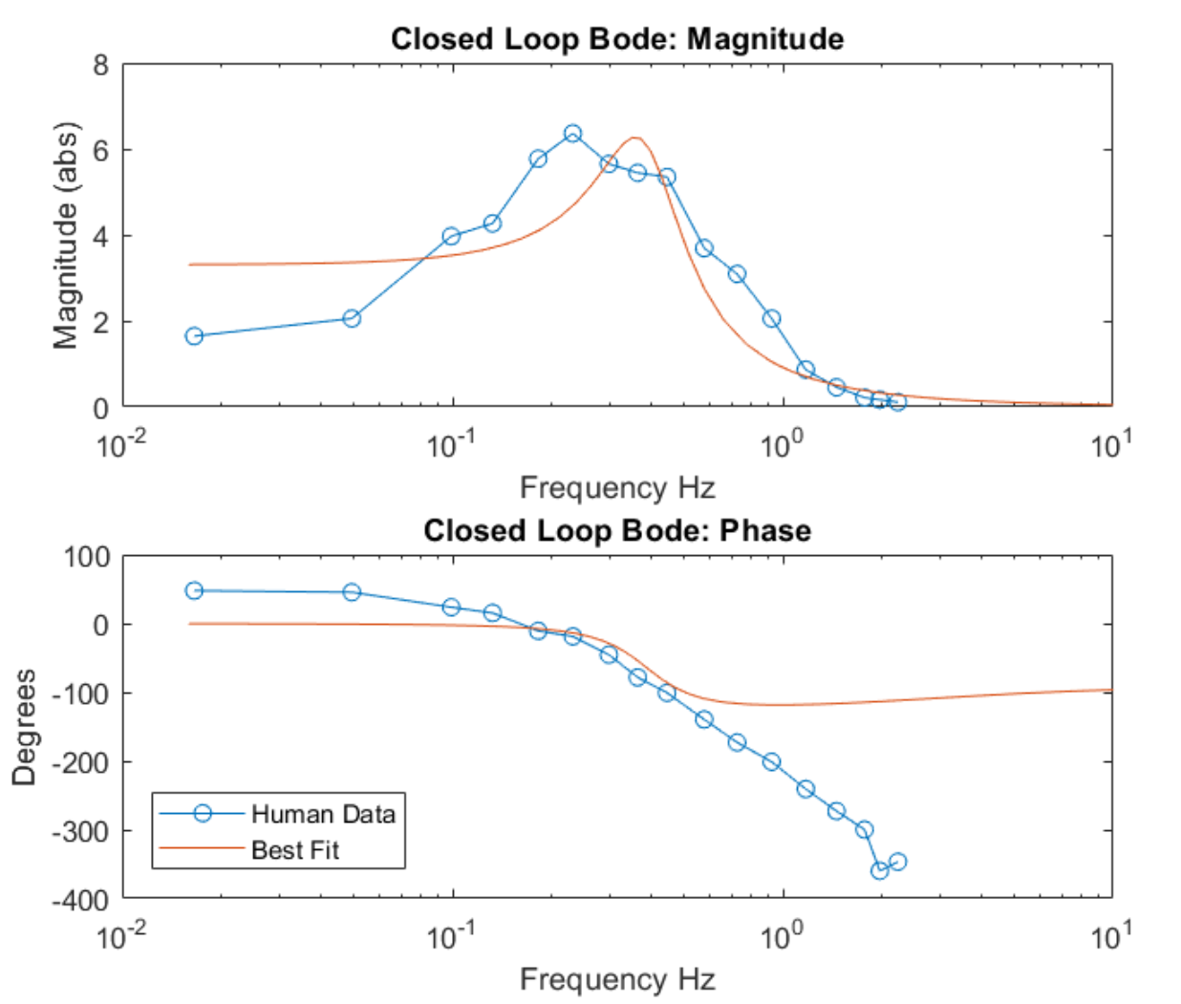
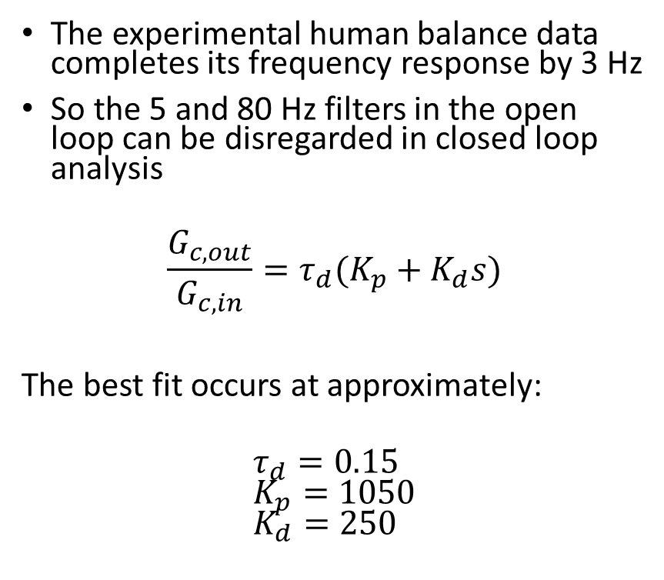
The closed loop frequency response occurs at such low frequencies that the neural PD can be modeled in the classical way
The experimental human balance data completes its frequency response by 3 Hz
So the 5 and 80 Hz filters in the open loop can be disregarded in closed loop analysis
$$\frac{G_{c,out}}{G_{c,in}}=τ_{d}(K_{p}+K_{d}s)$$ The best fit occurs at approximately:
$$τ_{d}=0.15 \\ K_{p}=1050 \\ K_{d}=250$$

Slide 21
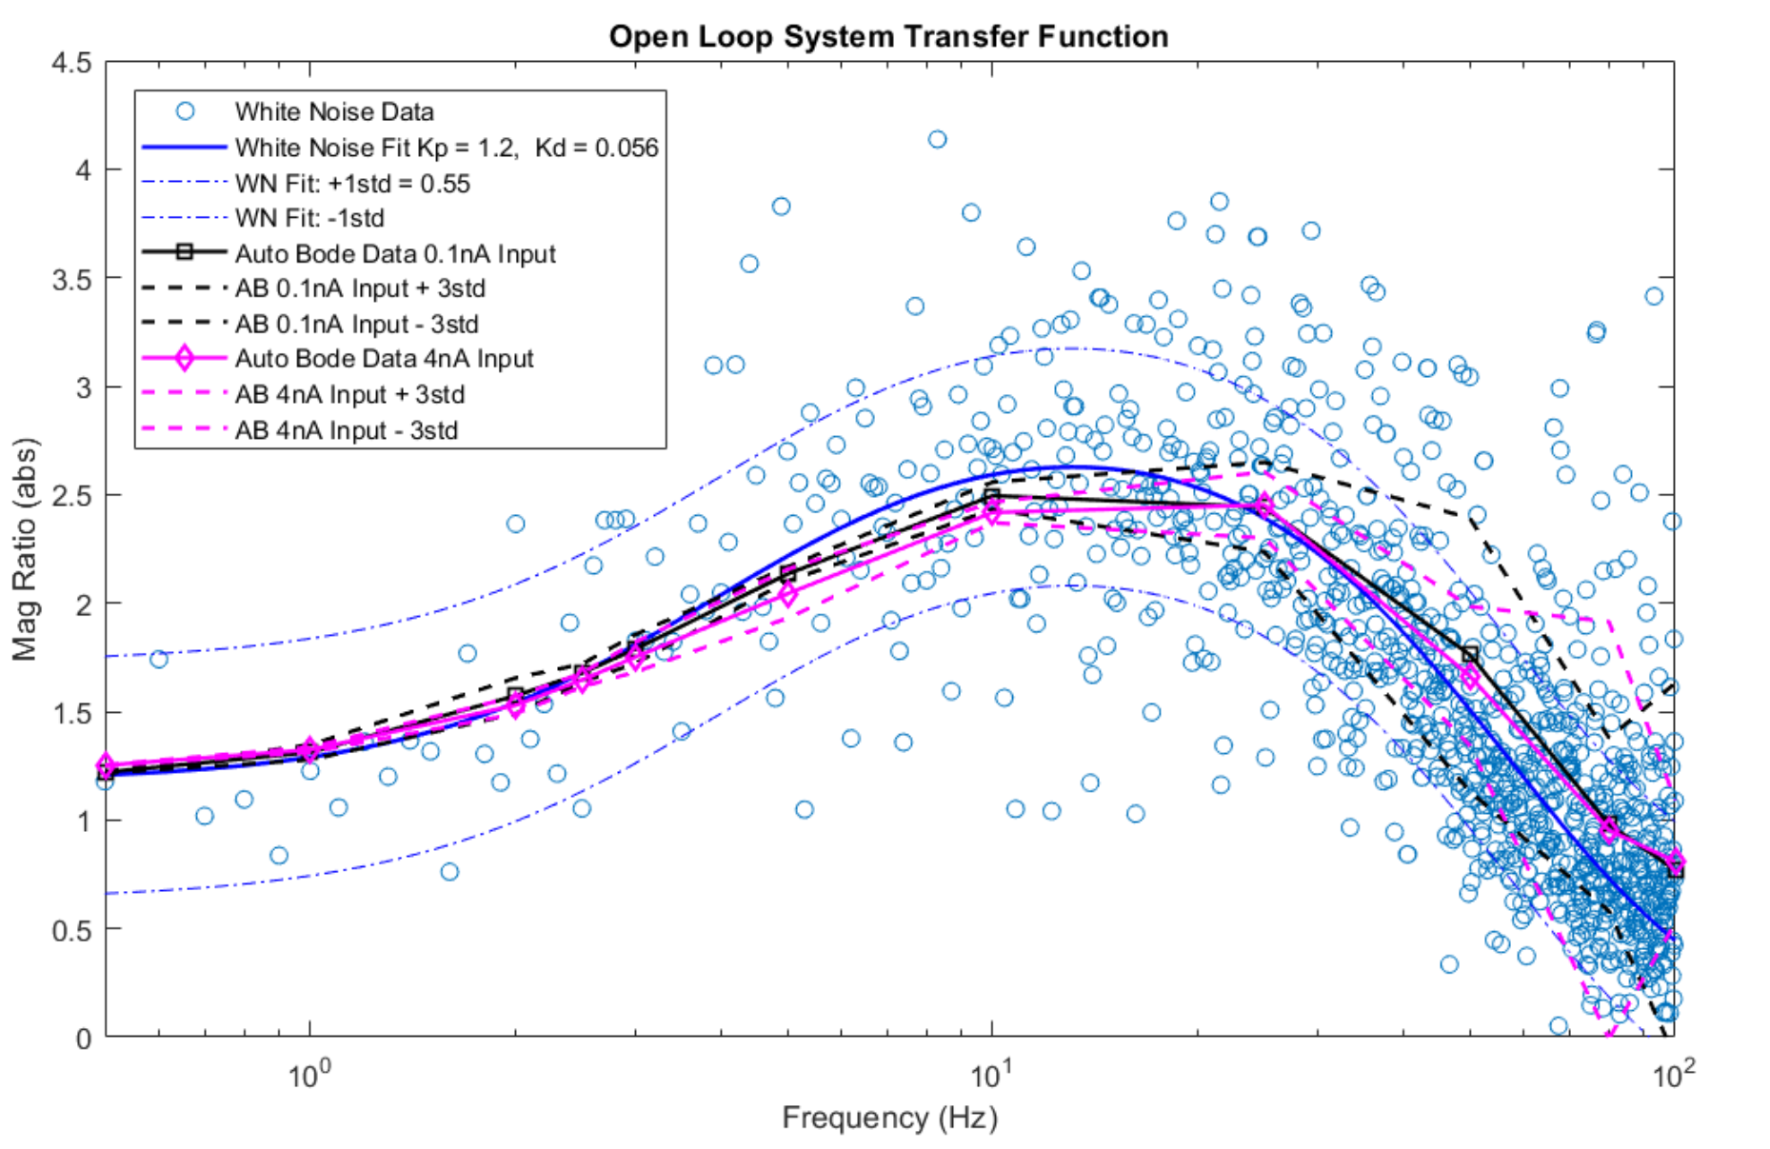
The neural PD shows no input dependence at neutral settings and gives baseline for FFT noise
Auto Bode shows no input dependence
White noise deviation is not related to input dependence, it represents the noise of the FFT method
Baseline FFT standard deviation is 0.55
Notes:
ABOL_10 input 0.1 & 4nA (has AB std dev) WNOL_5(0.5) Mfile for figs: Open_Loop_FA_WN_AB_Compare.m Mfile for Data Collection: Open_Loop_whiteNoise_ErrorAssessment.m

Slide 22
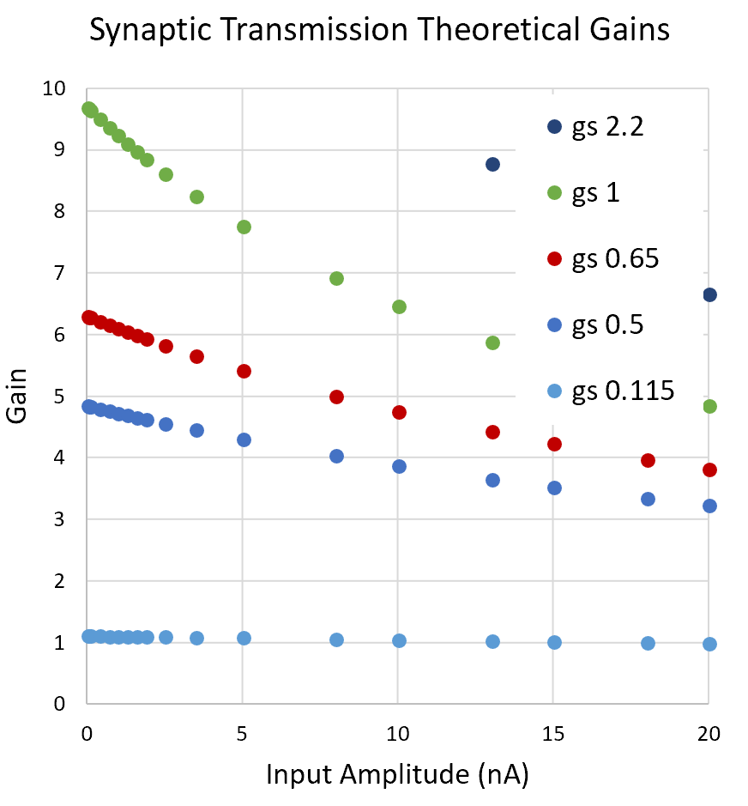
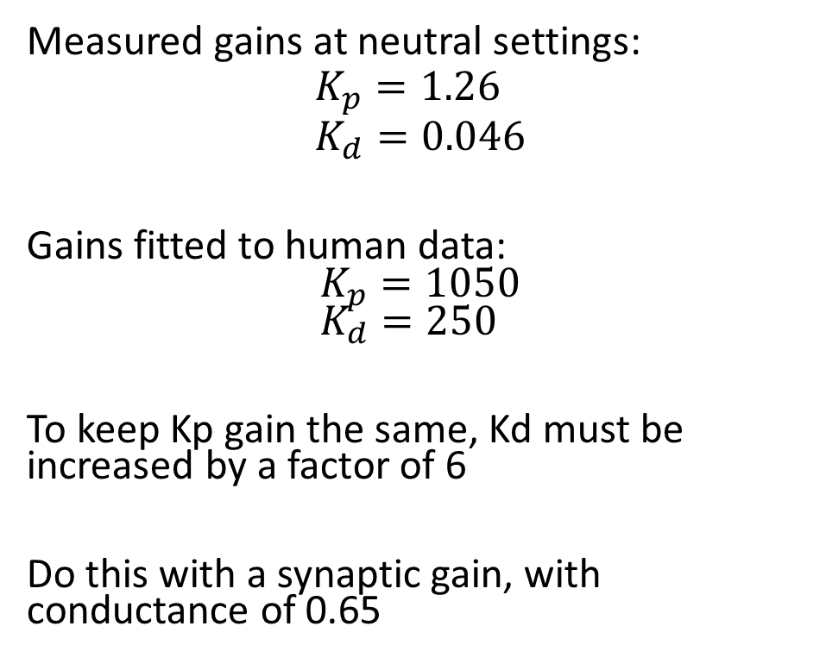
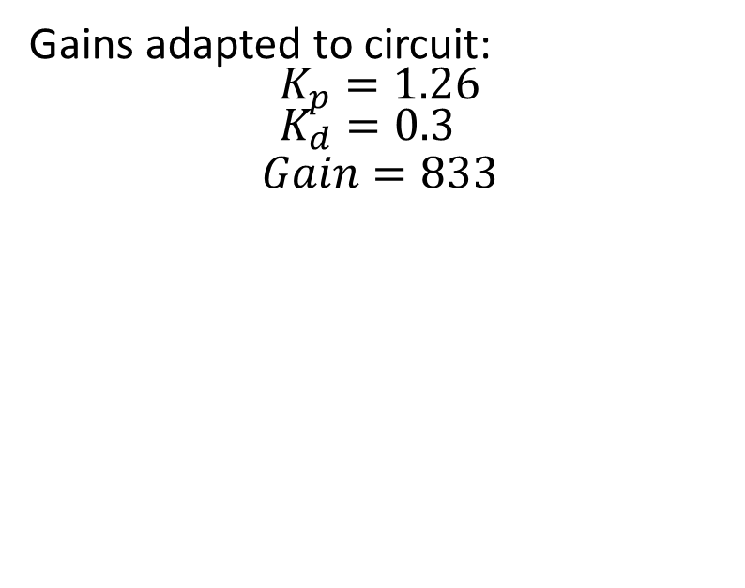
Design gains are implemented in the neural circuit by adding a Kd synaptic gain
Measured gains at neutral settings:
$$K_{p}=1.26 \\ K_{d}=0.046$$
Gains fitted to human data: $$K_{p}=1050 \\ K_{d}=250$$
To keep Kp gain the same, Kd must be increased by a factor of 6
Do this with a synaptic gain, with conductance of 0.65
Gains adapted to circuit:
$$K_{p}=1.26 \\ K_{d}=0.3$$
$$Gain=833$$

Slide 23
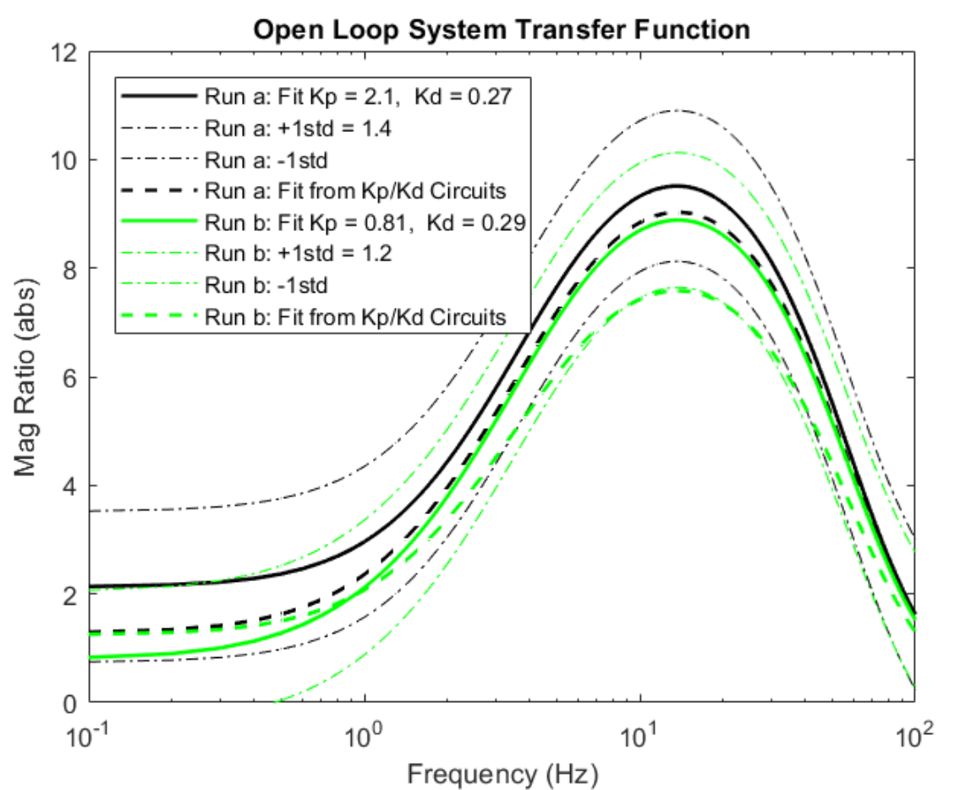
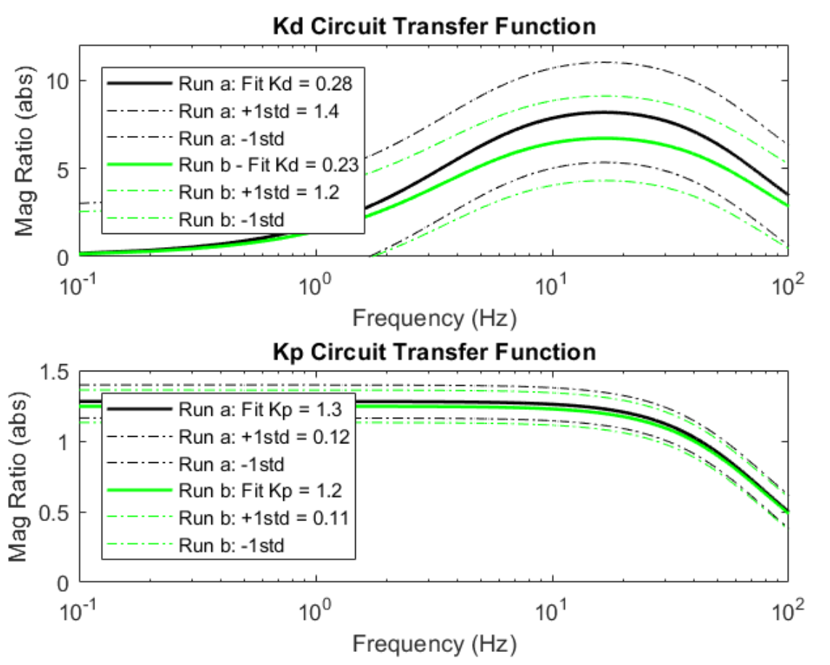
New circuit with Kd synaptic gain shows signs of input dependence
Compare Mean Input ~0.2nA (Run a - Black) to Mean Input ~1.5nA (Run b - Green)
Notes:
Run a – WNOL_64(0.2) Run b – WNOL_66(1.5) Auto Bode: ABOL_12(0.1) (tried input mean of 3nA, but Kd circuit was unstable) Mfile: Open_Loop_FA_WN_Compare.m

Slide 24
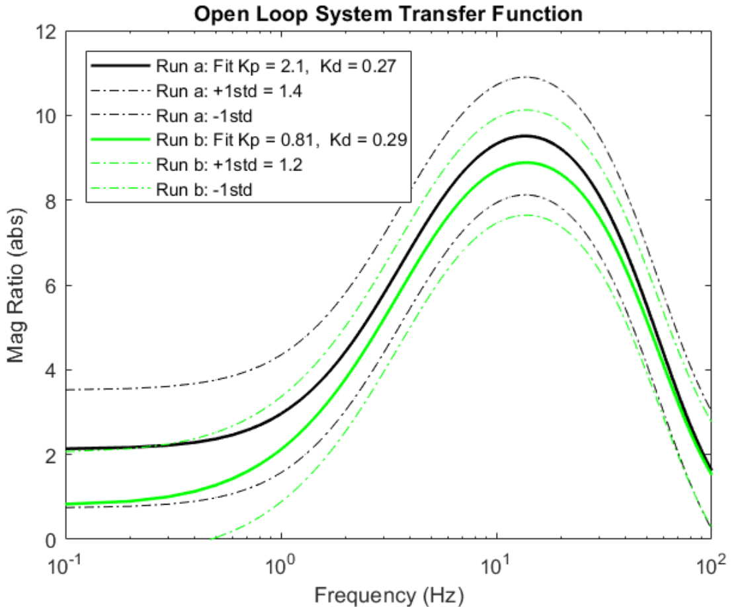
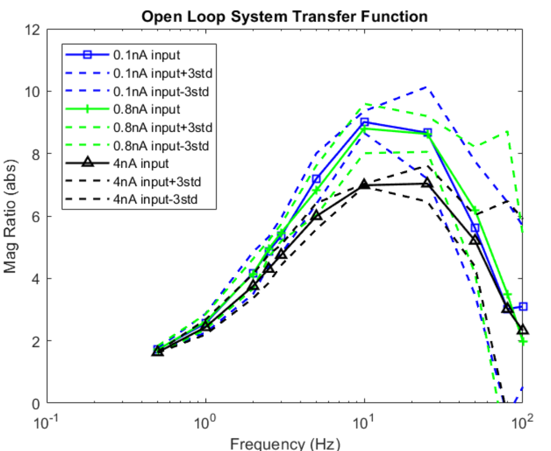
Input dependence is detected for controller with Kd synaptic gain
Auto Bode checked at small, mean, and max input from White Noise
WN Mean Input ~0.2nA (Run a - Black)
WN Mean Input ~1.5nA (Run b - Green)
Notes:
Run a – WNOL_64(0.2) Run b – WNOL_66(1.5) Auto Bode: ABOL_12 Series (0.1 ,0.8, 4) first sign of input dependence Mfile: Open_Loop_FA_WN_Compare.m

Slide 25
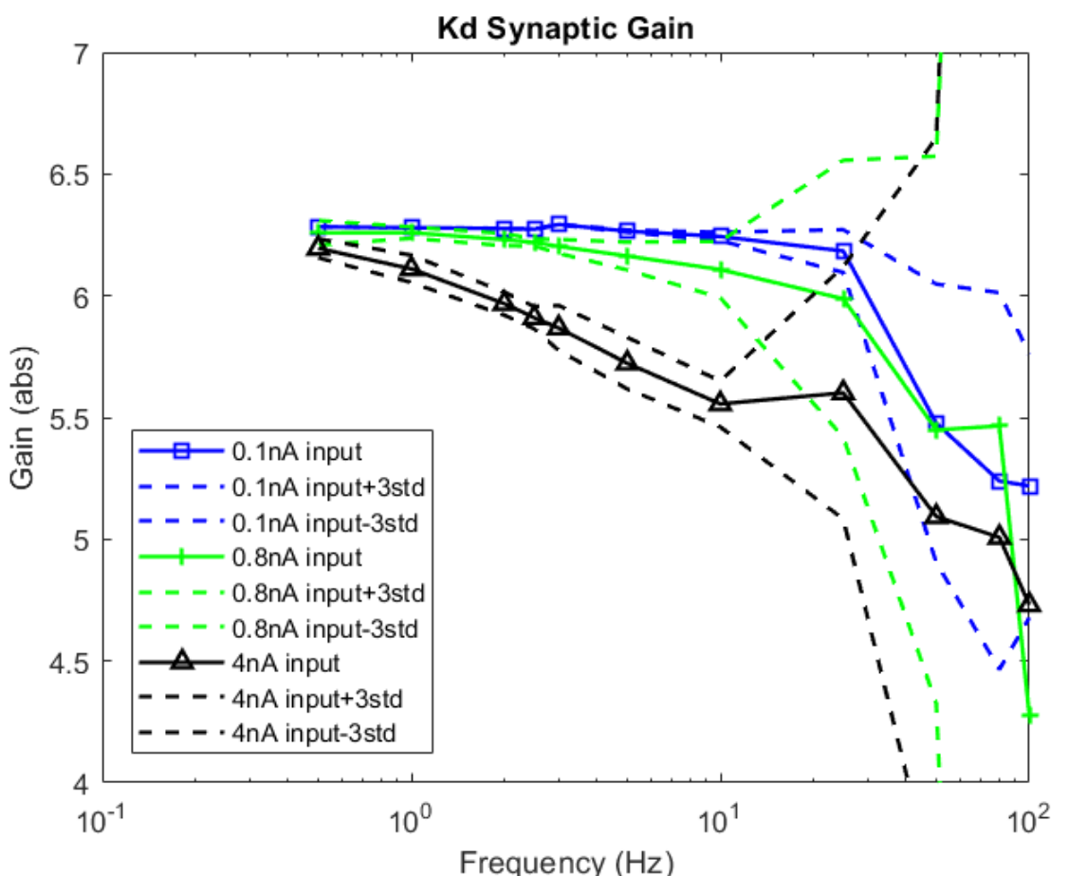
Input dependence is isolated to the Kd synaptic gain
Compare Theoretical Synaptic Gain to Actual Synaptic Gain for Kd Circuit
Notes:
Auto Bode: ABOL_12(0.1) first sign of input dependence Mfile: Open_Loop_FA_WN_Compare.m

Slide 26
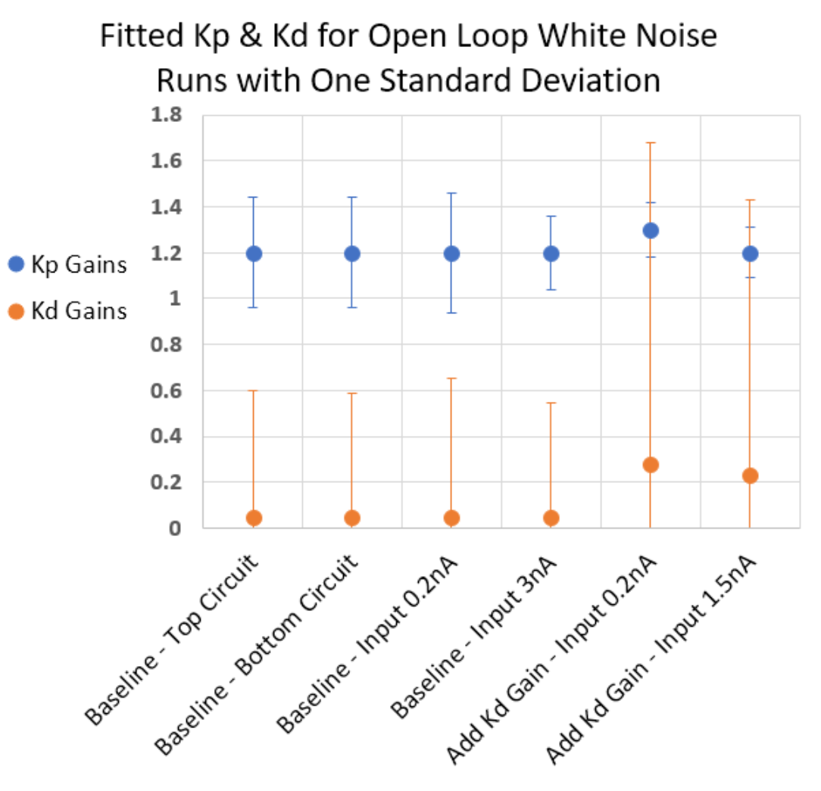
Standard deviations varying
Kd standard deviation increases significantly when synaptic gains are added
Kd synaptic gain causes input dependence - significant difference detected with Auto Bode
Notes:
Auto Bode: ABOL_12(0.1) first sign of input dependence Mfile: Open_Loop_FA_WN_Compare.m

Slide 27
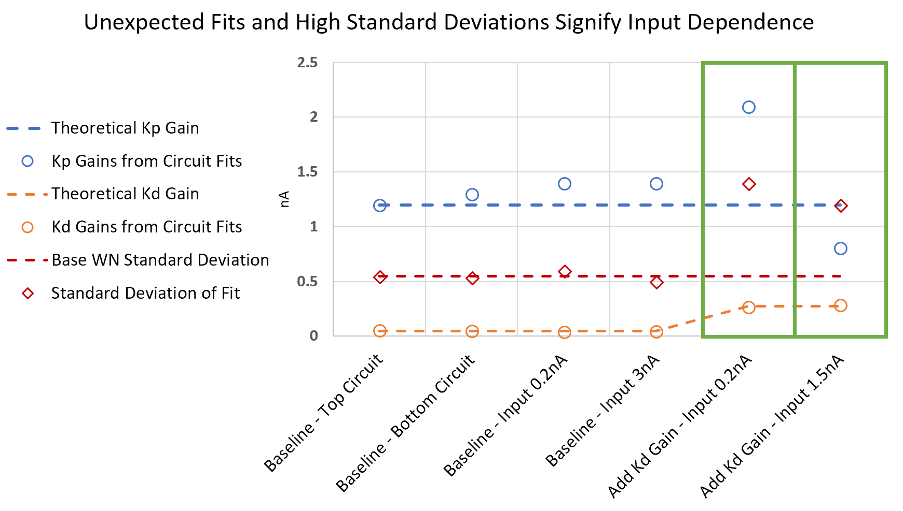
When fitted gains and standard deviations vary significantly from baseline, this is a sign of input dependence
Notes:
Auto Bode: ABOL_12(0.1) first sign of input dependence Mfile: Open_Loop_FA_WN_Compare.m

Slide 28
Implement our neural PD in the closed loop inverted pendulum system

Slide 29
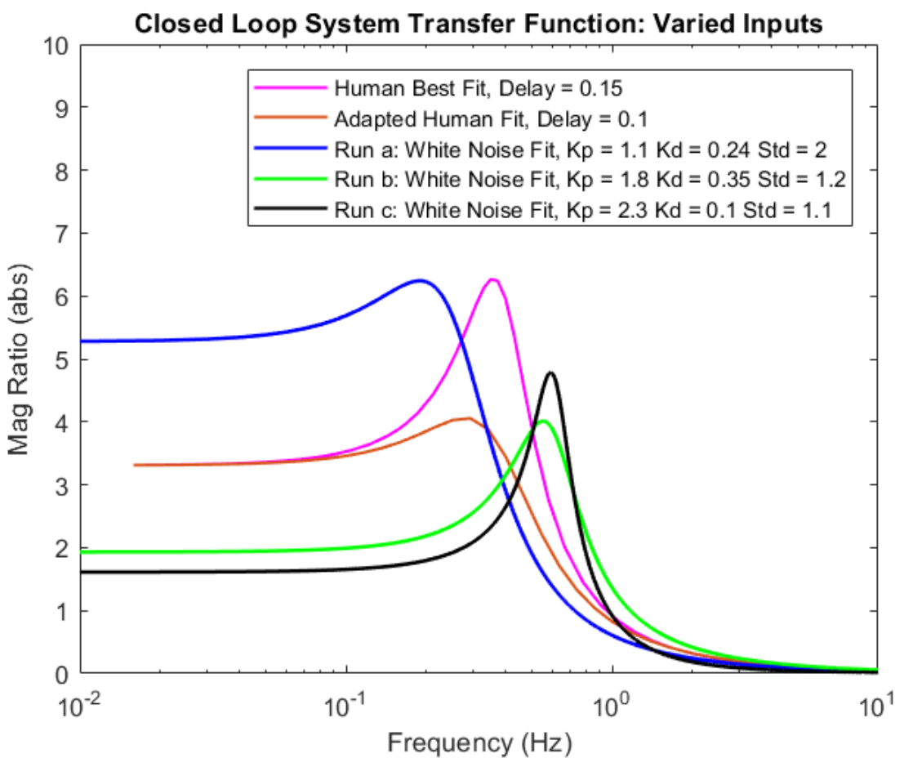
The closed system shows input dependence and approaches our designed fit to human data
Run a (Blue): 0.1nA Mean Input
Run b (Green): 0.6nA Mean Input
Run c (Black): 1.5nA Mean Input
Notes:
PRE-MOD baseline WNCL_69(0.1) – 0.1 input WNCL_11a(0.6) – 0.6 input WNCL_70(1.5) – 1.5 input Mfile: Closed_Loop_FA_WN_Compare3.m

Slide 30
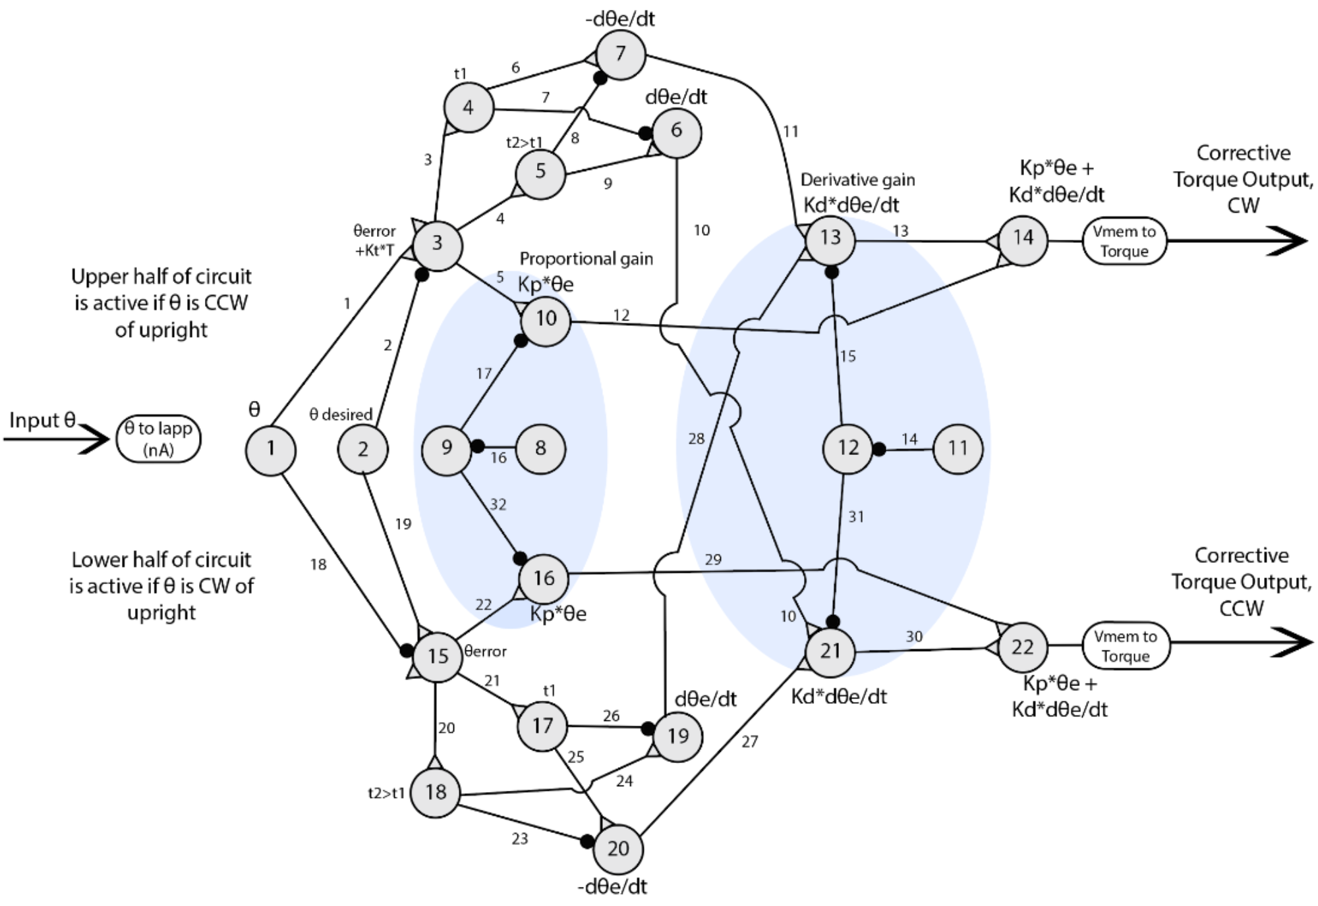
To add adaptive circuitry, we must utilize the modulation circuit neurons

Slide 31
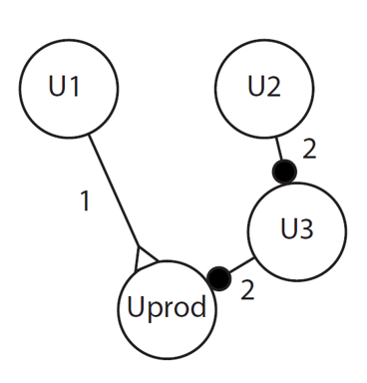
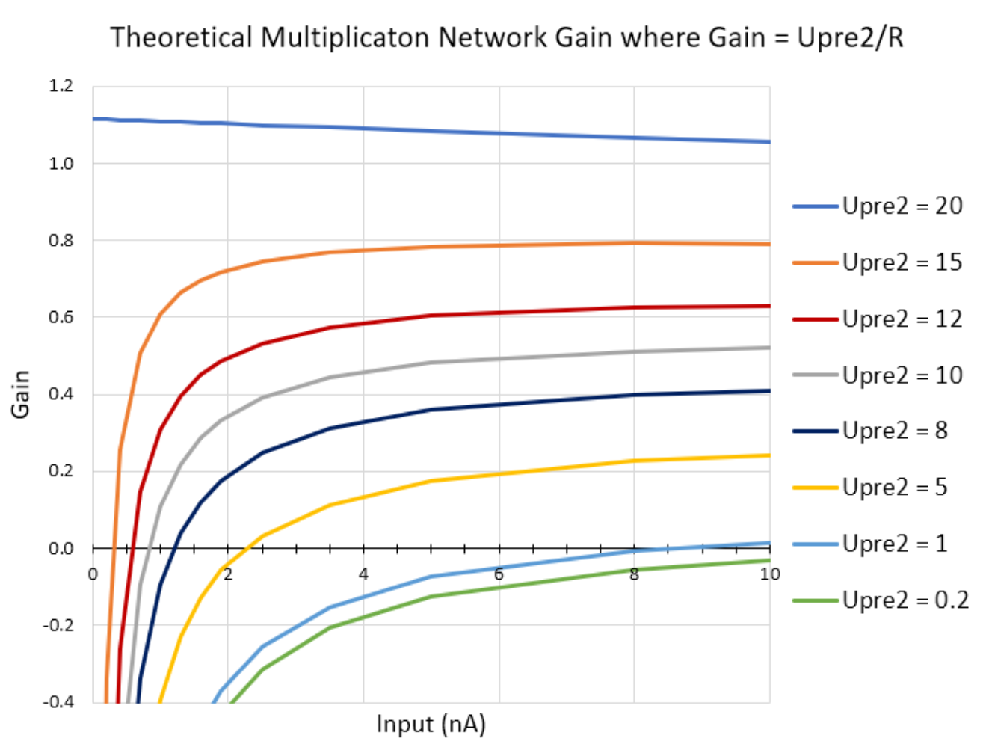
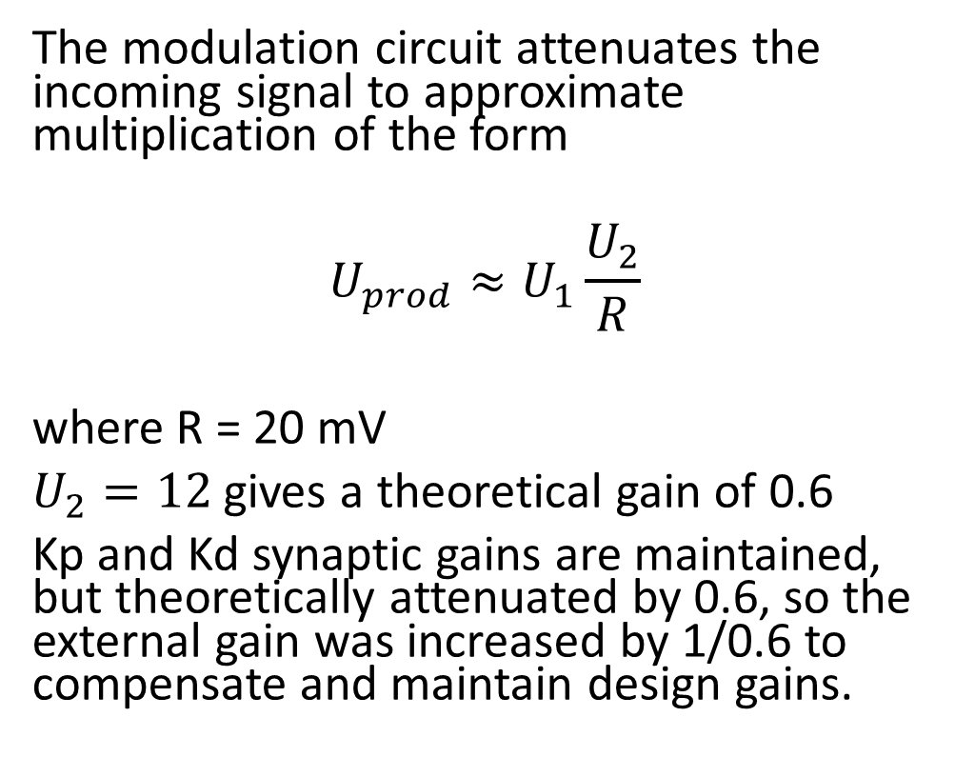
The modulation circuit introduces significant input dependence and truncates low input data
The modulation circuit attenuates the incoming signal to approximate multiplication of the form
$$U_{prod}≈U_{1}\frac{U_{2}}{R}$$
where R = 20 mV
$U_{2}=12$ gives a theoretical gain of 0.6
Kp and Kd synaptic gains are maintained, but theoretically attenuated by 0.6, so the external gain was increased by 1/0.6 to compensate and maintain design gains.

Slide 32
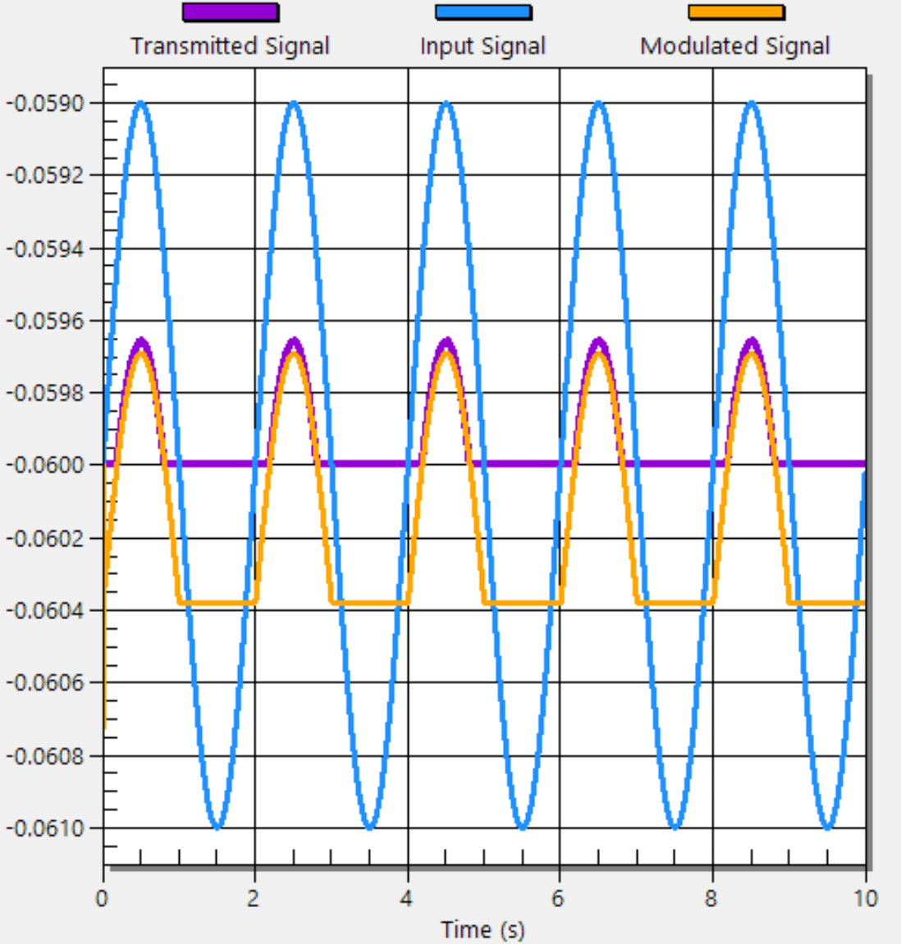

The modulation circuit applies the theoretical gain but inhibits the output neuron, pushing the data below the output threshold
Input data below the resting potential is lost
A theoretical offset of 0.6 pushes the modulated signal back into the positive range

Slide 33


The pre-mod and post-mod circuit responses are comparable for a 0.6nA input
Compare Pre-mod (Run a) to Post-mod (Run b) response for 0.6nA Input
Notes:
WNCL_11a(0.6) – pre-mod WNCL_32(0.6) – post-mod Mfile: Closed_Loop_FA_WN_Compare.m

Slide 34


The post-mod circuit shows very strange behavior at low inputs
Compare Pre-mod (Run a) to Post-mod (Run b) response for Extreme Inputs
Notes:
WNCL_69(0.1) – pre-mod WNCL_67(0.1) – post-mod WNCL_70(1.5) - pre-mod WNCL_68(1.6) - post-mod Mfile: Closed_Loop_FA_WN_Compare.m

Slide 35

System behavior changes significantly when error amplitudes increase
Notes:
ABCL_9 Series from 0.1 to 4nA input WNCL_32(0.6) – 0.6 Input Mfile: Closed_Loop_Batch_Bodes.m

Slide 36

The Kd parameter changes when error increases, so the controller varies over a single frequency response due to input dependence
Notes:
ABCL_9 Series from 0.1 to 4nA input Mfile: Closed_Loop_Batch_Bodes.m Each frequency (and input amplitude) are acted upon by a unique controller with unique gains, not one gain that fits the whole range. have the least gain when error is high and we need it most (would cause error term to yet increase more, contribute to instability and sharper peak), have the most gain when error is low and we need it least – contributes to high gains in low frequency range

Slide 37




We see input dependence in human experiments for eyes closed, non-VL subjects
Dr. Peterka observes that overall system gain decreases as input amplitude increases for non-VL subjects
As input increases, fitted Kp values are observed to increase
Normal Subject Data
Vestibular Loss Subject Data

Slide 38

Our measured mean Kp gains are very consistent, and we detect differences in Kd gains
Notes:
Auto Bode: ABOL_12(0.1) first sign of input dependence Mfile: Open_Loop_FA_WN_Compare.m Excel: Standard Deviatons Comparison.xlsx

Slide 39

Fitted Kp values are observed to increase in both the neural and human non-VL control systems
Notes:
Auto Bode: ABOL_12(0.1) first sign of input dependence Mfile: Open_Loop_FA_WN_Compare.m Excel: Standard Deviatons Comparison.xlsx

Slide 40
The neural system shows input dependence and we see similar overall gain and fitted gain parameter trends in human data Classical controls fits are useful in comparing to other research using classical methods Classical controls fits do not find accurate gains when input dependence is present Fits to human data might also find erroneous gains due to input dependence

Slide 41


Changing pendulum properties changes fitted gains in the opposite direction to trends seen in human data
Compare Baseline Inertia (Run a - black) to Altered Inertia (Run b - pink)
Notes:
WNCL_32(0.6) – post-mod baseline WNCL_36(0.6) – post-mod Inertia 53% (-40,-40) WNCL_35(0.6) - post-mod Inertia 152% (+40,+40) Mfile: Closed_Loop_FA_WN_Compare.m

Slide 42
The modulation circuit is the primary obstacle to incorporating adaptive feedback networks
In classical controls, multiplication is critical
The modulation circuit truncates and distorts data in an asymmetrical way
Possible solutions
Design a new multiplication network from the ground up
Design a network whose sole purpose is to adaptively change the offset of the multiplication network
Notes:
WNCL_11a(0.6) – pre-mod WNCL_32(0.6) - post-mod Mfile:

Slide 43

Thanks for listening!!
Questions?
Notes:
http://dfc.com/keep-calm-and-use-your-neurons-deep-breathing-and-the-human-brain/

